Slide 1
Object Oriented Programming
Prof. Varsha Dange

Slide 2
Section 2 Lecture – 26
Prof. Varsha Dange

Slide 3
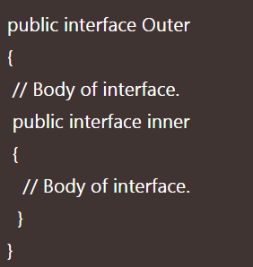
Nested Interface in Java
When an interface is declared inside a class or another interface, it is called nested interface in java.
Nested interface must be declared as public inside another interface.
The nested interfaces are used to group related interfaces so that they can be easy to maintain.
The nested interface can be declared in the following general form.

Slide 4
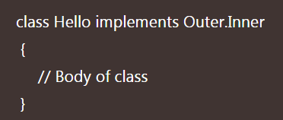
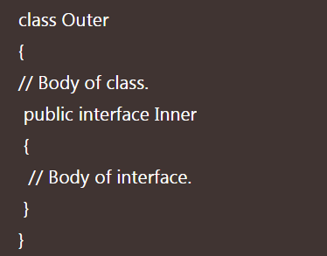
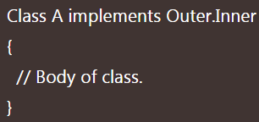
Nested Interface in Java
The nested interface must be referred to by the outer interface or class. It can't be accessed directly.
A class can implement nested interface Inner by using the following below statement.
Interface inside Class:
The general syntax to define an interface inside a class in java is as follows:

Slide 5
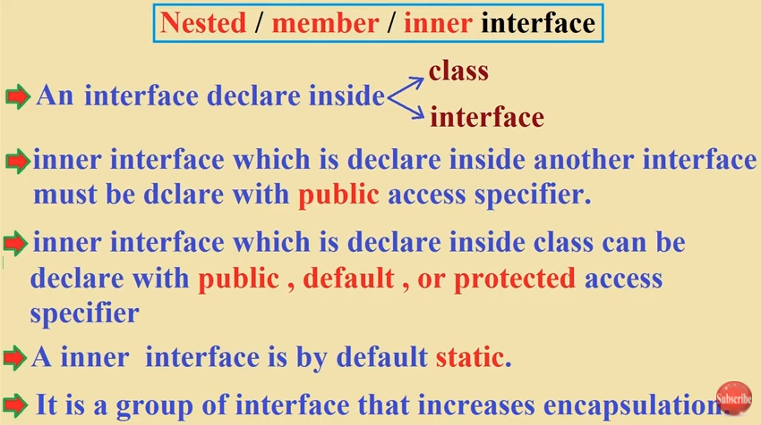

Nested Interface in Java

Slide 6
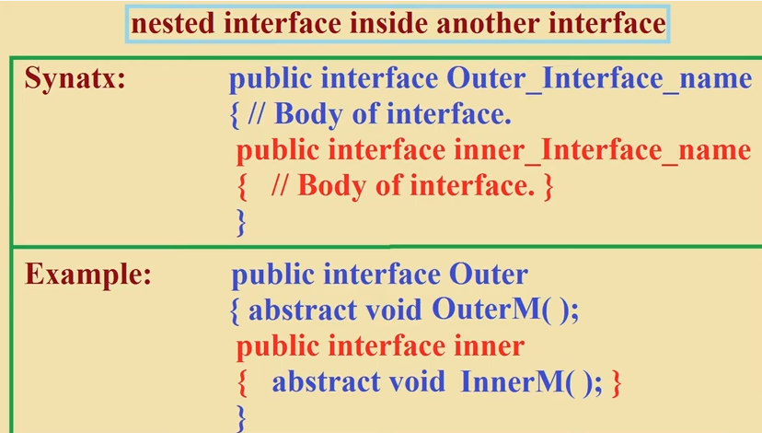
Nested Interface in Java

Slide 7
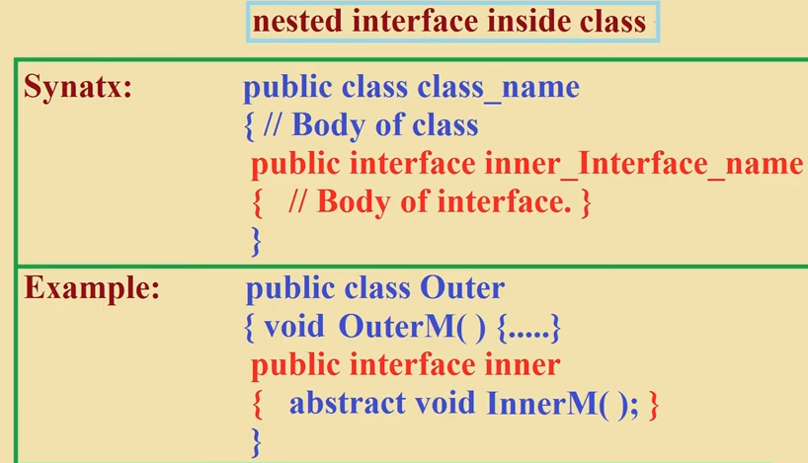
Nested Interface in Java

Slide 8
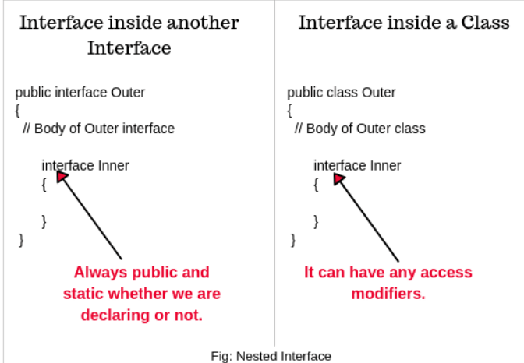
Nested Interface in Java
Every inner interface or class is always implicitly public and static whether we are declaring or not.
If you declare inner interface inside a class then it can have any access modifiers.

Slide 9
Nested Interface in Java
When you implement an outer interface, you are not required to provide implementation for inner interface. We can directly implement the outer interface.
Similarly, when you implement an inner interface, you are not required to provide implementation for outer interface because inner interface is always public and static.
we can implement inner interface directly without implementing outer interface.
Example

Slide 10
Interface inside Class
If you require multiple implementations of an interface and all these implementations are related to a particular class, It is highly recommended to define an interface within a class.
Example

Slide 11
Difference between Abstract class and Interface
Keyword used:
a. keywords abstract is used to define an abstract class. b. keyword interface is used to define an interface.
Keyword used by implementing class:
a. To inherit the abstract class, we use the extends keyword. b. To implement an interface, we can use the implements keyword.
Variables:
a. Abstract class can have final, non-final, static, and non-static variables. b. Interface cannot have any instance variables. It can have only static final variables.

Slide 12
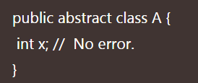
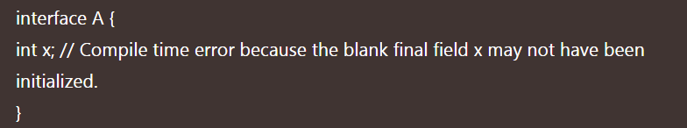
Difference between Abstract class and Interface
Initialization:
a. The abstract class variable does not require performing initialization at the time of declaration. For example:
b. Interface variable must be initialized at the time of declaration otherwise we will get compile-time error. For example:

Slide 13
Difference between Abstract class and Interface
Method:
a. Every method present inside an interface is always public and abstract whether we are declaring or not. That’s why interface is also known as pure (100%) abstract class. b. An abstract class can have both abstract and non-abstract (concrete) methods.
Constructors:
a. Inside an interface we cannot declare/define a constructor.
b. An abstract class can have instance variables. Therefore, we can define constructors within the abstract class to initialize instance variables.

Slide 14
Difference between Abstract class and Interface
Static and Instance blocks:
a. cannot declare instance and static blocks inside an interface. If declare them, will get compile time error. b. can declare instance and static blocks inside abstract class.
Access modifiers:
a. cannot define any private or protected members in an interface. All members are public by default. b. There is no restriction in declaring private or protected members inside an abstract class.

Slide 15
Difference between Abstract class and Interface
Single vs Multiple inheritance:
a. A class can extend only one class (which can be either abstract or concrete class) b. A class can implement any number of interfaces. (multiple inheritance)

Slide 16
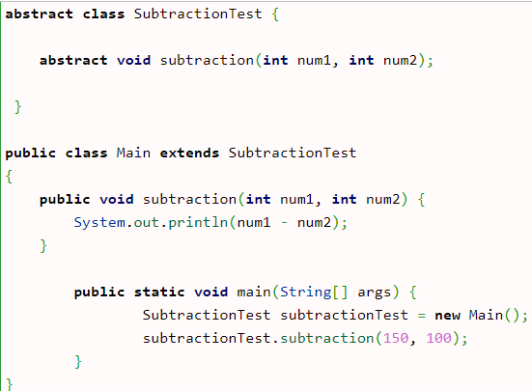
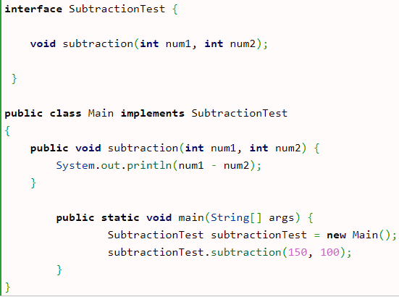
Difference between Abstract class and Interface

Slide 17
Marker Interface/tag interface
The marker interface in Java interfaces with no field or methods
empty interface in java is called a marker interface.
Whenever a class implementing Marker interface, that class acquire some capability to perform some operation.
Example of marker interface is Serializable, Cloneable, and Remote interface.
it indicates a signal or command to the JVM.

Slide 18
Uses of Marker Interface
Marker interface is used as a tag that inform the Java compiler by a message so that it can add some special behavior to the class implementing it.
Implementing an empty interface tells the compiler to do some operations.

Slide 19
Cloneable interface
Clonable interface in Java is also a marker interface that belong to java.lang package.
It generates replica (copy) of an object with different name.
We can implement the interface in the class of which class object to be cloned. It impliments the clone() method of the Object class.
If we do not implement the Cloneable interface in the class and invokes the clone() method, it throws the CloneNotSupportedException.
Example

Slide 20
Serializable interface
It is a marker interface in Java that is defined in the java.io package.
If we want to make the class serializable, we must implement the Serializable interface.
If a class implements the Serializable interface, we can serialize or deserialize the state of an object of that class.
Serialization (converting an object into byte stream) is a mechanism in which object state is read from the memory and written into a file or database.
Deserialization (converting byte stream into an object) is the opposite of serialization means that object state reading from a file or database and written back into memory is called deserialization of object.
Serialization (writing) can be achieved with the ObjectOutputStream class and deserialization (reading) can be achieved with the ObjectInputStream class.
Example

Slide 21
Serializable interface
It is a marker interface in Java that is defined in the java.io package.
If we want to make the class serializable, we must implement the Serializable interface.
If a class implements the Serializable interface, we can serialize or deserialize the state of an object of that class.
Serialization (converting an object into byte stream) is a mechanism in which object state is read from the memory and written into a file or database.
Deserialization (converting byte stream into an object) is the opposite of serialization means that object state reading from a file or database and written back into memory is called deserialization of object.
Serialization (writing) can be achieved with the ObjectOutputStream class and deserialization (reading) can be achieved with the ObjectInputStream class.
Example

Slide 22
Remote interface
Remote interface is a marker interface that belong to java.rmi package.
It marks an object as remote that can be accessed from another machine (host).
must implement the Remote interface if we want to make an object as remote.
It identifies the interfaces whose methods can be invoked from a non-local JVM.
Any remote object must implement the interface directly or indirectly.

